Slide 1

Big Data
CouchDB

Slide 2
Agenda
Document store
CouchDB introduction
CouchDB demo

Slide 3
Document store - Concept
Document-oriented database (aka “document store”)
Subclass of key-value store
Includes internal structure or metadata
Schemaless => adjustments to the DB are transparent
Notes:
Documents include internal structure (or metadata) opposed to key-value store
Schemaless - advantage: schema migrations become very easy. With a traditional RDB, releases of code might contain data migration scripts. Further, each release should have a reverse migration script in case a rollback is necessary. ALTER TABLE operations can be very slow and result in scheduled downtime.

Slide 4
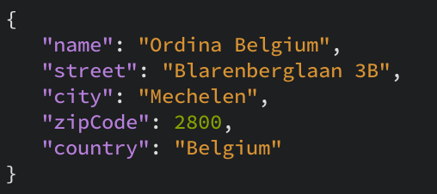
JSON document

Slide 5
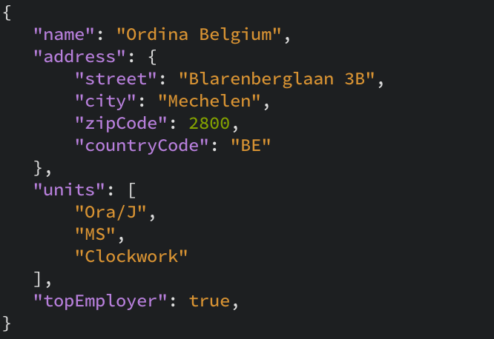
JSON document (cont.)

Slide 6
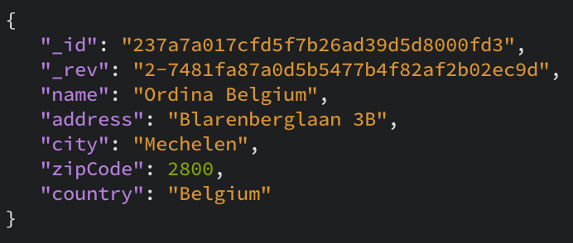
JSON document (metadata)
Notes:
----- Meeting Notes (26/05/15 20:34) -----
revision?

Slide 7
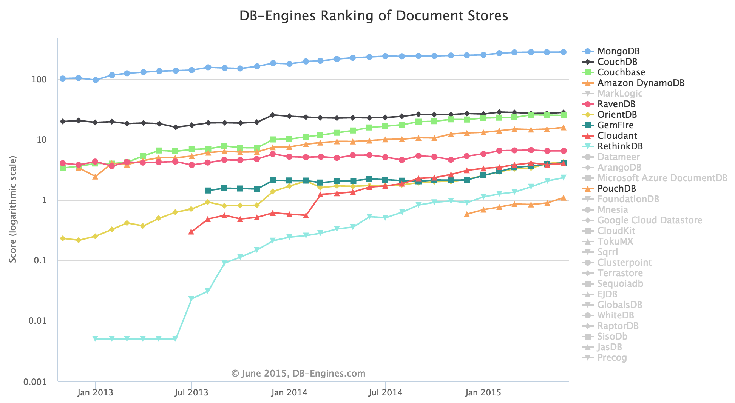
Document-oriented databases
Notes:
Why CouchDB and not MongoDB?
All of these databases probably have their advantages/use cases.
Licensed under Apache
----- Meeting Notes (26/05/15 21:04) -----
ravendb

Slide 8

CouchDB
Cluster Of Unreliable Commodity Hardware

Slide 9


CouchDB intro – Multi-master replication
Master
Master
Backup / archive
Master
Slave

Slide 10
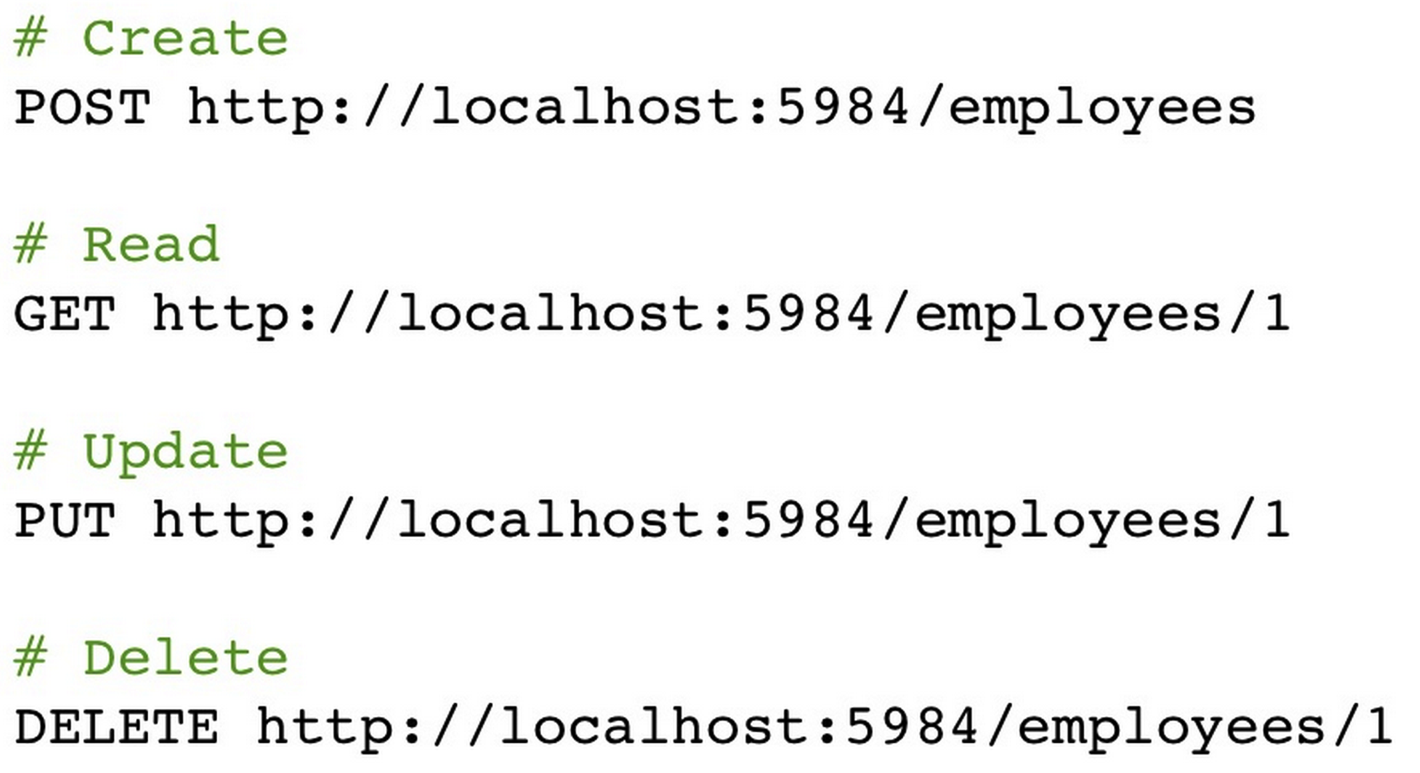
RESTful API
Notes:
RESTful - From creation to replication to data insertion, every management and data task can be done via HTTP.

Slide 11
CouchDB intro (cont.)
JSON document-oriented database
Highly concurrent
Append-only database
Makes use of map/reduce to index and query the database
Built for Offline
Replication Filters
Binary data storage (attachments)
Notes:
Highly concurrent database - designed to be easily replicable, horizontally, across numerous devices and be fault tolerant.
Append only database - new updates are appended to the database and do not overwrite the old document. Each new update to a JSON document with a pre-existing ID will add a new revision (note: revisions are used as part of the replication system, it is not designed to be used as a revision control system).
Built for Offline - CouchDB can replicate to devices (like Android phones) that can go offline and handle data sync for you when the device is back online.
Replication Filters – Choose precisely the data you wish to replicate to other nodes.
----- Meeting Notes (26/05/15 21:04) -----
conflict resolution

Slide 12
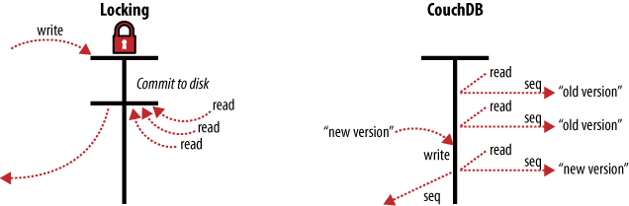
CouchDB intro - MVCC
Multiversion Concurrency Control
Notes:
provide concurrent access to the database

Slide 13
CouchDB vs MongoDB
Multi-master replication vs Replica set
Availability vs Consistency (see CAP theorem)
Predefined Views (map functions) vs Dynamic queries
“Giant datastore” vs Collections
Notes:
Note: The replication process only copies the last revision of a document, so all previous revisions that were only on the source database are not copied to the destination database.
Availability means that all clients can always read and write. Consistency means that each client always has the same view of the data.
In MongoDB – nodes host the same data set (replica set), one is primary, others secondary. Primary is used for all read/write ops. Replication is used for redundancy.
In CouchDB – Eventual consistency. Clients write to one node without waiting for other nodes to come into agreement. The system incrementally copies document changes between nodes, meaning that they will eventually be in sync.
----- Meeting Notes (26/05/15 21:04) -----
consistency

Slide 14
Views
Used for extracting/filtering documents
Part of MapReduce
Index built during query
Built from changes feed
Having many indexes doesn’t slow down new document insertion
The very first query to a view can take a while to complete
Notes:
MapReduce is a programming model for processing and generating large data sets with a parallel, distributed algorithm on a cluster.

Slide 15
Core data storage
Can manage any number of logical databases
Each DB backed by a single file in the filesystem
Each view stored in separate file
Any new data is appended to the end of the file
Old data can be cleaned up by “compaction”
Notes:
Only limited by disk space and file descriptors on filesystem.
It is not uncommon to set up a database architecture with CouchDB where every single user gets their own database.
Extreme resilience against data loss.
Compaction walks the changes feed and copies all most recent document versions into a new file => automically swaps the old and the new file and deletes the old file.
----- Meeting Notes (26/05/15 21:04) -----
compaction

Slide 16
Use cases
Large Hadron Collider
http://readwrite.com/2010/08/26/lhc-couchdb
http://www.couchbase.com/sites/default/files/pdf/case-studies/Cern%20CB%20-%202010%20Aug.pdf
CERN
https://cloudant.com/blog/moving-from-oracle-to-couchdb-data-management-at-cern/#.VT-q-1xk_dk
Notes:
CMS collects roughly 10PB of data per year
a small number of users, but an amount of data similar to Facebook's
designed for distributed environments

Slide 17
Demo

